Slide 1
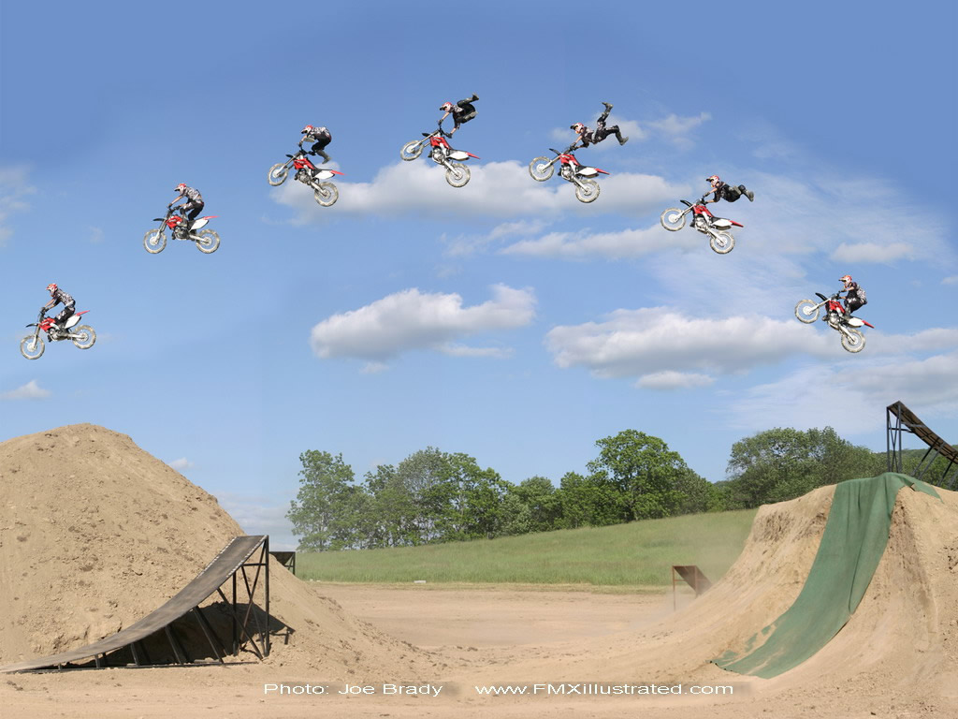
Projectile Motion
In this lesson you will learn how objects move under the influence of gravity in two dimensions.
The definition of a projectile will also be defined

Slide 2
Learning Goals
By the end of this lesson, you will be able to:
define projectile
explain the effects of gravity on moving objects
solve projectile motion problems for horizontally launched objects
solve projectile motion problems for projectiles launched at angles

Slide 3
Success Criteria
Can I:
explain the effects of gravity on moving objects
distinguish between horizontal motion and vertical motion of a projectile
define what is meant by a projectile
solve for projectile motion problems for objects launched horizontally and at angles.

Slide 4
Definition of a projectile
A projectile is a object that is launched from the surface of the Earth, moving under the influence of gravity alone.
projectiles are not self-propelled, i.e. they do not have motors or engines
projectiles will not be affected by air resistance in this course
projectiles can be launched horizontally or at angles, θ, to the surface of the Earth

Slide 5
Effects of Gravity
Since air resistance does not affect the projectile, the x-comp of the velocity remains constant
Since gravity acts in the vertical dir, the y-comp of the velocity changes because gravity causes a vertical acceleration
When you combine constant horizontal motion with accelerating vertical motion the result is projectile motion.

Slide 6
Since the motion is different in the x-dir and the y-dir, there are two equations which must be used
x-direction (horizontal)
used to find the range
of the projectile
y-direction (vertical)
used to find the time of
flight of the projectile

Slide 7
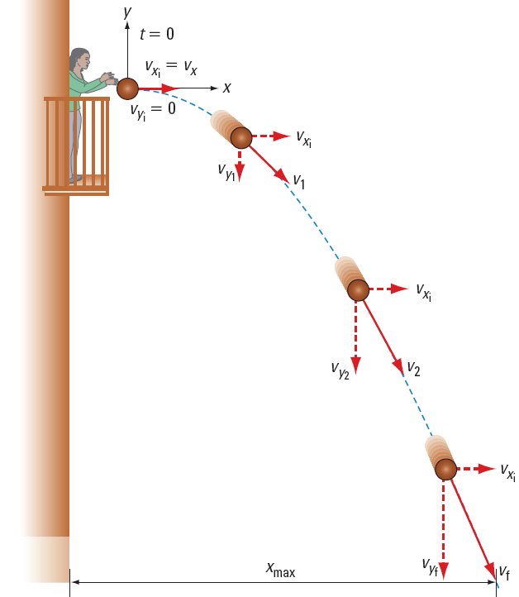
Horizontally Launched Projectiles
projectiles launched horiz have initial y-comp vel equal to zero, v_{iy} = 0 and an angle of zero, θ = 0

Slide 8
The eqn’s become
x-direction (horizontal)
y-direction (vertical)
used to find the range
of the projectile
used to find the time of flight
of the projectile

Slide 9
PRACTICE Problem
1. A water balloon is thrown horizontally out a window 5.5 m high at 12 m/s. What is the time of flight of the water balloon?

Slide 10
PRACTICE Problem
2. What is the range of the water balloon in practice question 1?

Slide 11
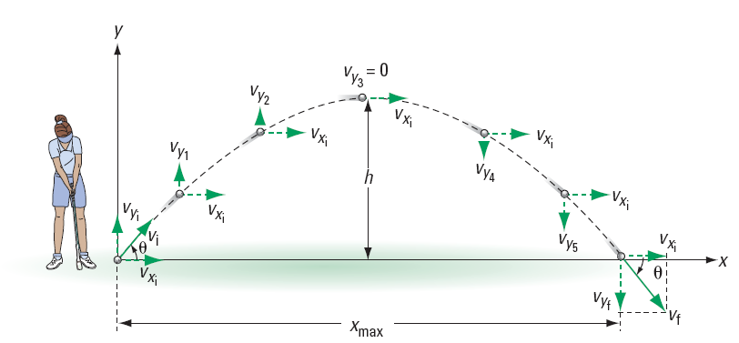
Projectiles Launched at angles
Projectiles launched at angles can be separated into two cases:
Case 1: Δd_{y} = 0
In this case the projectile is launched and lands in the same plane. eg a golf ball

Slide 12
The eqn’s become
x-direction (horizontal)
y-direction (vertical)

Slide 13
Some questions ask you to find the max height of the projectile.
Find Δt
Divide Δt by 2. (max h occurs at half the time of flight)
Use this time in the Δd_{y} eqn

Slide 14
PRACTICE Problem
3. A soccer ball is kick at 18 m/s [R35ºU]. What is the time of flight of the soccer ball?

Slide 15
PRACTICE Problem
4. What is the range of the soccer ball?

Slide 16
PRACTICE Problem
5. What is the max height of the soccer ball?

Slide 17
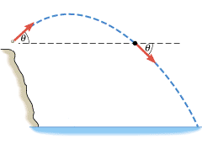
Case 2: Δd_{y} ≠ 0
In this case the projectile lands in a different plane. eg a tennis ball thrown off a cliff

Slide 18
For this case, we can only use the general equations
x-direction (horizontal)
y-direction (vertical)

Slide 19
Sample Problem
A rock is thrown off a 20. m cliff at 15 m/s [R35ºU].
Determine the time of flight and the range of the rock.
Sol’n:
v_{i} = 15 m/s
θ = 35º
Δd_{y} = -20. m
Δt = ?
Δd_{x} = ?

Slide 20
∴ the time of flight is 3.1 s
∴ the range is 38 m

Slide 21
PRACTICE Problem
6. A soccer ball is kick onto the roof of a school 15. m high at 24 m/s [R55ºU]. Determine the time of flight
7. What is the range of the soccer ball?

Slide 22
HOMEWORK
Read Section 2.3
Review Tutorial 1 and 2
Questions 1 – 2 pg 78
1 – 2 pg 81
1 – 8 pg 81

